Slide 1
BUS 297D: Data Mining
Professor David Mease
Lecture 4
Agenda:
1) Go over HW #1 solutions (Due today)
2) Assign HW #2 (Due Thurs 9/17)
3) Lecture over Chapter 6
4) Discuss Midterm Exam

Slide 2
Homework 1
Homework 1 is at
http://www.cob.sjsu.edu/mease_d/bus297D/homework1.html
It is due Thursday, September 10 during class
It is work 70 points
It must be printed out using a computer and turned in during the class meeting time. Anything handwritten on the homework will not be counted. Late homeworks will not be accepted.

Slide 3
Homework 2
Homework 2 is at
http://www.cob.sjsu.edu/mease_d/bus297D/homework2.html
It is due Thursday, September 17 during class
It is work 30 points
It must be printed out using a computer and turned in during the class meeting time. Anything handwritten on the homework will not be counted. Late homeworks will not be accepted.

Slide 4
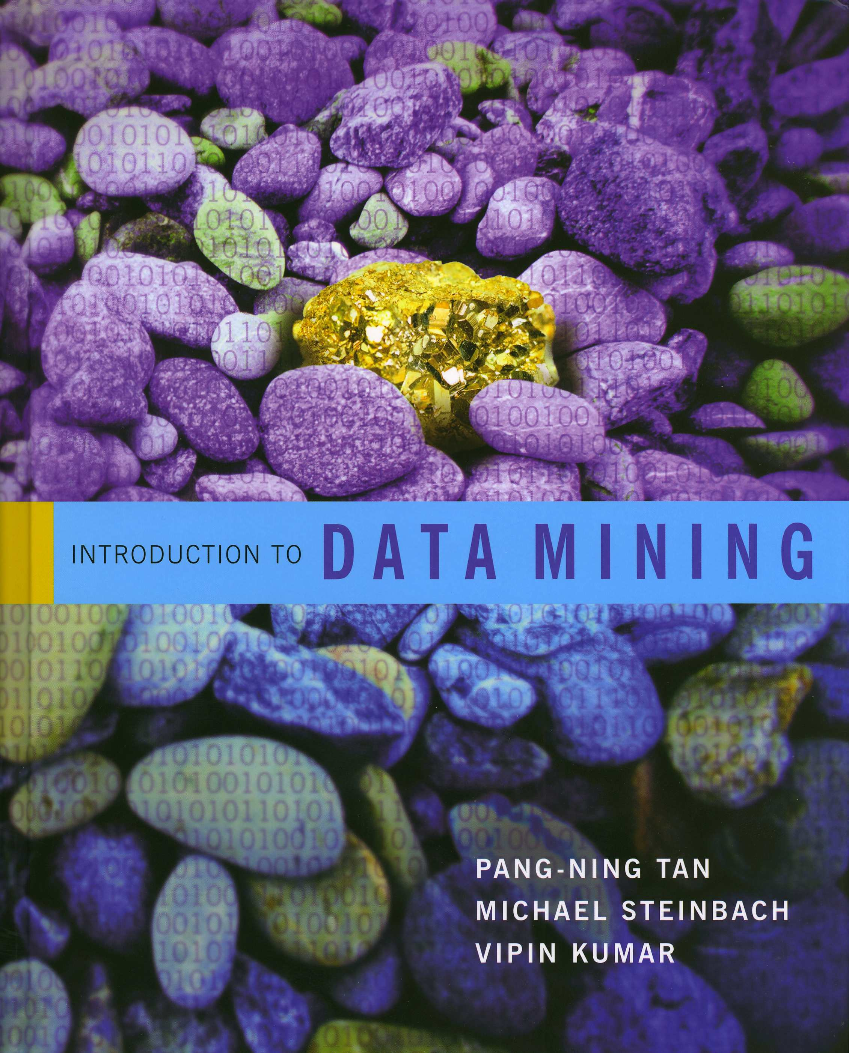
Introduction to Data Mining
by
Tan, Steinbach, Kumar
Chapter 6: Association Analysis

Slide 5

What is Association Analysis:
Association analysis uses a set of transactions to discover rules that indicate the likely occurrence of an item based on the occurrences of other items in the transaction
Examples:
{Diaper} → {Beer},
{Milk, Bread} → {Eggs,Coke}
{Beer, Bread} → {Milk}
Implication means co-occurrence, not causality!

Slide 6
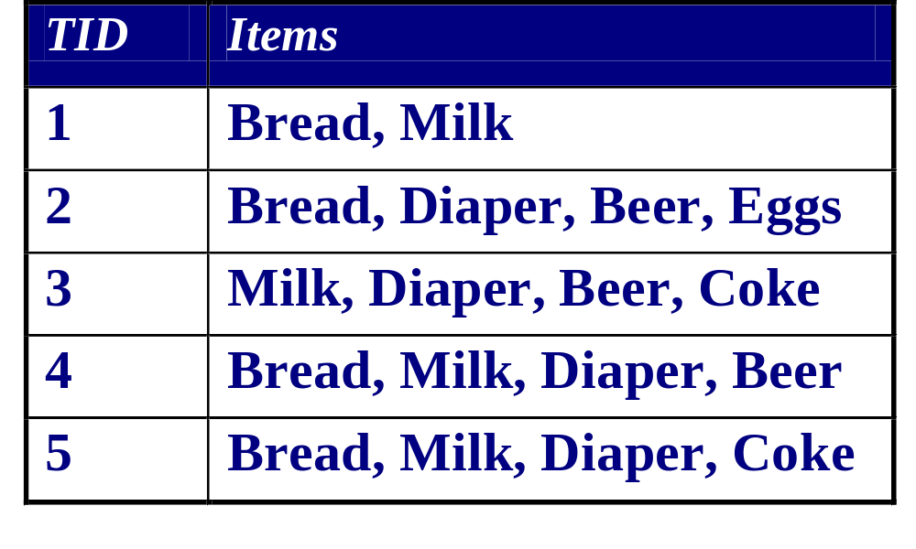
Definitions:
Itemset
  A collection of one or more items
  Example: {Milk, Bread, Diaper}
  k-itemset = An itemset that contains k items
Support count (σ)
  Frequency of occurrence of an itemset
  E.g. σ({Milk, Bread,Diaper}) = 2
Support
  Fraction of transactions that contain an itemset
  E.g. s({Milk, Bread, Diaper}) = 2/5
Frequent Itemset
  An itemset whose support is greater than or equal to a minsup threshold

Slide 7
Another Definition:
Association Rule
  An implication expression of the form X → Y, where X and Y are itemsets
  Example:
  {Milk, Diaper} → {Beer}

Slide 8

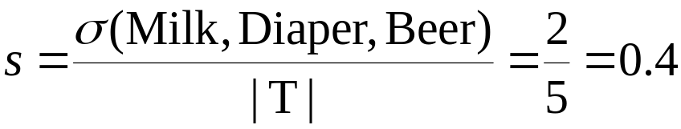

Even More Definitions:
Association Rule Evaluation Metrics
  Support (s)
    =Fraction of transactions that contain both X and Y
  Confidence (c)
    =Measures how often items in Y appear in transactions that contain X
Example:

Slide 9
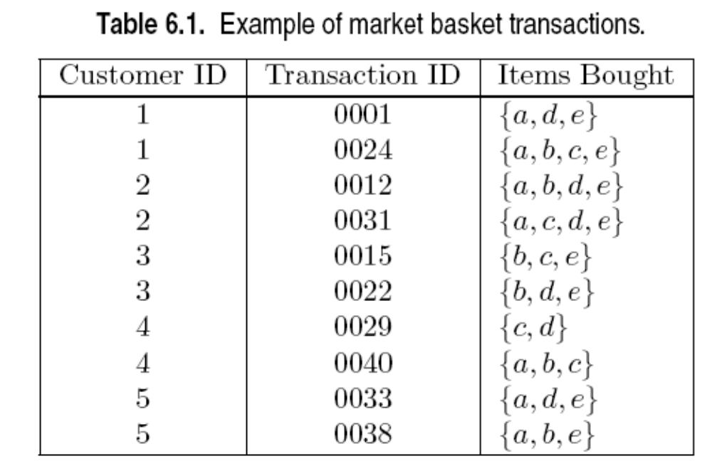
In class exercise #26:
Compute the support for itemsets {a}, {b, d}, and {a,b,d} by treating each transaction ID as a market basket.

Slide 10
In class exercise #27:
Use the results in the previous problem to compute the confidence for the association rules {b, d} → {a} and {a} → {b, d}. State what these values mean in plain English.

Slide 11
In class exercise #28:
Compute the support for itemsets {a}, {b, d}, and {a,b,d} by treating each customer ID as a market basket.

Slide 12
In class exercise #29:
Use the results in the previous problem to compute the confidence for the association rules {b, d} → {a} and {a} → {b, d}. State what these values mean in plain English.

Slide 13
In class exercise #30:
The data www.stats202.com/more_stats202_logs.txt
contains access logs from May 7, 2007 to July 1, 2007. Treating each row as a "market basket" find the support and confidence for the rule
Mozilla/5.0 (compatible; Yahoo! Slurp; http://help.yahoo.com/help/us/ysearch/slurp)→
74.6.19.105

Slide 14
An Association Rule Mining Task:
Given a set of transactions T, find all rules having both
- support ≥ minsup threshold
- confidence ≥ minconf threshold
Brute-force approach:
- List all possible association rules
- Compute the support and confidence for each rule
- Prune rules that fail the minsup and minconf thresholds
- Problem: this is computationally prohibitive!

Slide 15
The Support and Confidence Requirements can be Decoupled
All the above rules are binary partitions of the same itemset: {Milk, Diaper, Beer}
Rules originating from the same itemset have identical support but can have different confidence
Thus, we may decouple the support and confidence requirements
{Milk,Diaper} → {Beer} (s=0.4, c=0.67)
{Milk,Beer} → {Diaper} (s=0.4, c=1.0)
{Diaper,Beer} → {Milk} (s=0.4, c=0.67)
{Beer} → {Milk,Diaper} (s=0.4, c=0.67)
{Diaper} → {Milk,Beer} (s=0.4, c=0.5)
{Milk} → {Diaper,Beer} (s=0.4, c=0.5)

Slide 16
Two Step Approach:
1) Frequent Itemset Generation
= Generate all itemsets whose support ≥ minsup
2) Rule Generation
= Generate high confidence (confidence ≥ minconf ) rules from each frequent itemset, where each rule is a binary partitioning of a frequent itemset
Note: Frequent itemset generation is still computationally expensive and your book discusses algorithms that can be used

Slide 17
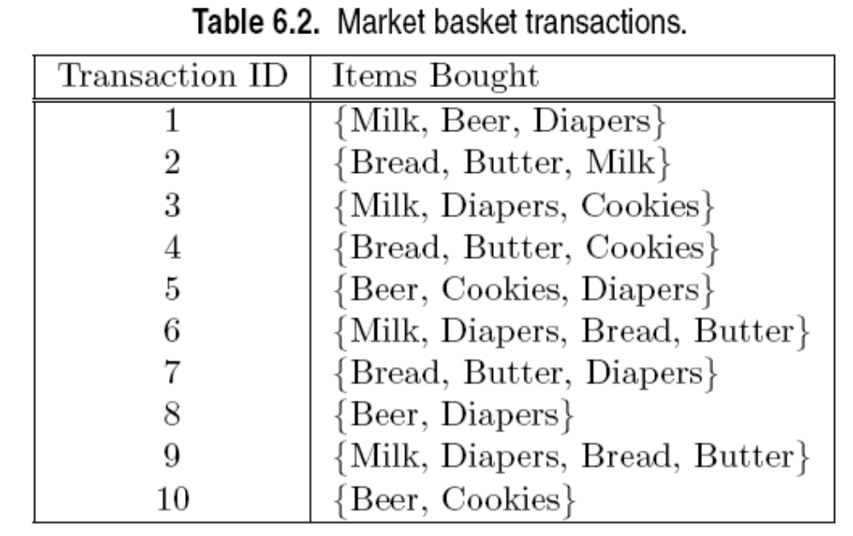
In class exercise #31:
Use the two step approach to generate all rules having support ≥ .4 and confidence ≥ .6 for the transactions below.

Slide 18
Drawback of Confidence
Association Rule: Tea → Coffee
Confidence(Tea → Coffee) = P(Coffee|Tea) = 0.75
 | Coffee | Coffee
Tea | 15 | 5 | 20
Tea | 75 | 5 | 80
 | 90 | 10 | 100

Slide 19
Drawback of Confidence
Association Rule: Tea → Coffee
Confidence(Tea → Coffee) = P(Coffee|Tea) = 0.75
but support(Coffee) = P(Coffee) = 0.9
Although confidence is high, rule is misleading
confidence(Tea → Coffee) = P(Coffee|Tea) = 0.9375
 | Coffee | Coffee
Tea | 15 | 5 | 20
Tea | 75 | 5 | 80
 | 90 | 10 | 100

Slide 20
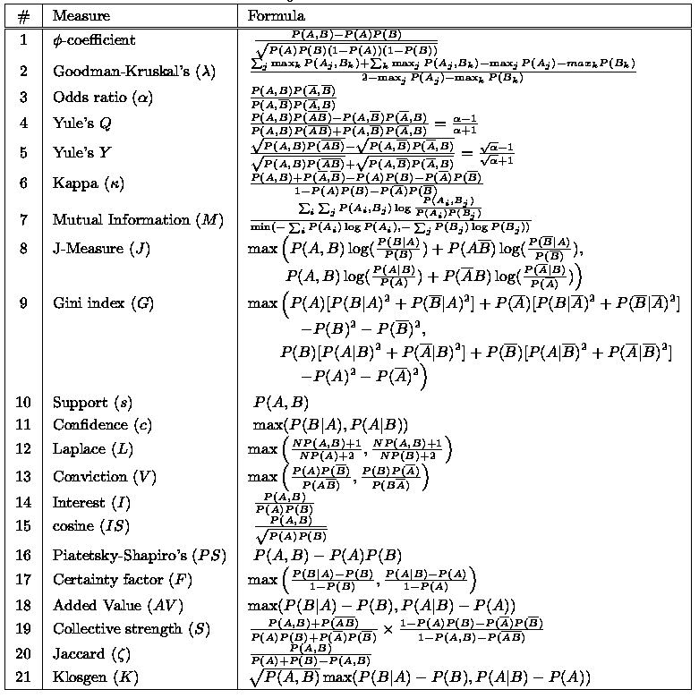
Other Proposed Metrics:

Slide 21
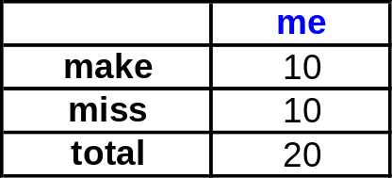
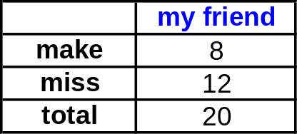
Simpson’s “Paradox” (page 384)
Occurs when a 3rd (possibly hidden) variable causes the observed relationship between a pair of variables to disappear or reverse directions
Example: My friend and I play a basketball game and each shoot 20 shots. Who is the better shooter?

Slide 22
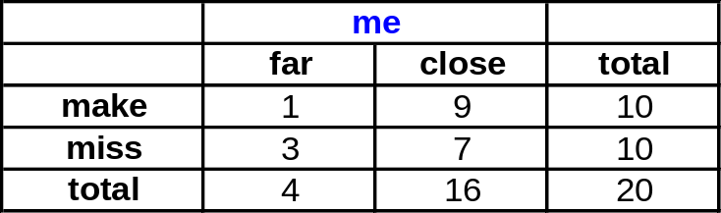
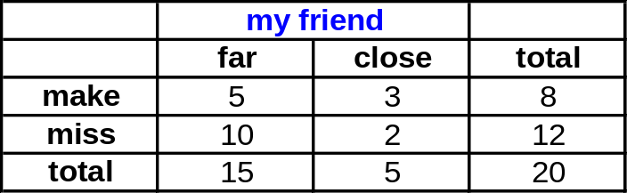
Simpson’s “Paradox” (page 384)
Occurs when a 3rd (possibly hidden) variable causes the observed relationship between a pair of variables to disappear or reverse directions
Example: My friend and I play a basketball game and each shoot 20 shots. Who is the better shooter?
But, who is the better shooter if you control for the distance of the shot? Who would you rather have on your team?

Slide 23
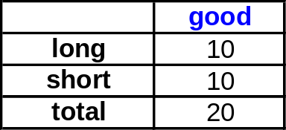
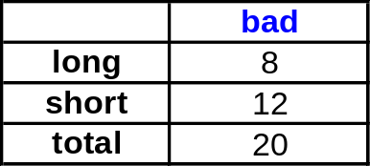
Another example of Simpson’s “Paradox”
A search engine labels web pages as good and bad. A researcher is interested in studying the relationship between the duration of time a user spends on the web page (long/short) and the good/bad attribute.

Slide 24
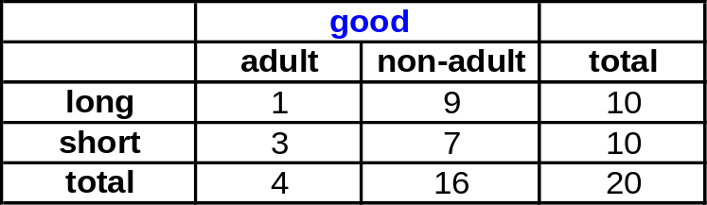
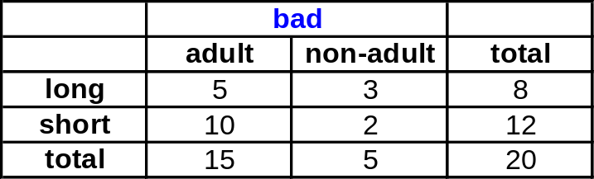
Another example of Simpson’s “Paradox”
A search engine labels web pages as good and bad. A researcher is interested in studying the relationship between the duration of time a user spends on the web page (long/short) and the good/bad attribute.
It is possible that this relationship reverses direction when you control for the type of query (adult/non-adult). Which relationship is more relevant?

Slide 25
Midterm Exam:
The midterm exam will be Thursday 9/17
You are allowed one 8.5 x 11 inch sheet (front and back) containing notes
No books or computers are allowed, but please bring a hand held calculator
The exam will cover the material from the first 4 lectures and the first two homeworks (Chapters 1, 2, 3 and 6)

Slide 26
Sample Midterm Question #1:
What is the definition of data mining used in your textbook?
A) the process of automatically discovering useful information in large data repositories
B) the computer-assisted process of digging through and analyzing enormous sets of data and then extracting the meaning of the data
C) an analytic process designed to explore data in search of consistent patterns and/or systematic relationships between variables, and then to validate the findings by applying the detected patterns to new subsets of data

Slide 27
Sample Midterm Question #2:
If height is measured as short, medium or tall then it is what kind of attribute?
A) Nominal
B) Ordinal
C) Interval
D) Ratio

Slide 28
Sample Midterm Question #3:
If my data frame in R is called “data”, which of the following will give me the third column?
A) data[2,]
B) data[3,]
C) data[,2]
D) data[,3]
E) data(2,)
F) data(3,)
G) data(,2)
H) data(,3)

Slide 29
Sample Midterm Question #4:
If I have 100 values in my data and I add 5.0 to all of the values, then how will this change the standard deviation?
A) it will not change
B) it will become larger than the median
C) it will become smaller than the median
D) it will increase by 0.5
E) it will increase by 5
F) it will increase by some about, but we do not have enough information to determine how much
G) it may increase or may stay the same

Slide 30
Sample Midterm Question #5:
What is the R command to change the default directory which we used in class?
A) chdir()
B) ls()
C) ls-a()
D) cd()
E) cd-a()
F) setwd()
G) go()

Slide 31
Sample Midterm Question #6:
We often need to add noise to the points in a scatter plot in what situation?
A) when we are uncertain of our values
B) when both attributes are nominal
C) when both attributes are discrete
D) when neither attribute is ratio
E) when neither attribute is nominal
F) when we sample to reduce the number of points

Slide 32
Sample Midterm Question #7:
A histogram using points and lines instead of bars is called what?
A) bar chart
B) pie chart
C) polygon
D) pareto diagram
E) ogive

Slide 33
Sample Midterm Question #8:
If the mean is larger than the median then this might be an indication that the data is what?
A) discrete
B) continuous
C) filled with a lot of missing values
D) observational
E) experimental
F) right-skewed
G) left-skewed

Slide 34
Sample Midterm Question #9:
Compute the confidence for the association rule
{b, d} → {a} by treating each row as a market basket. Also, state what this value means in plain English.

